Slide 1

Visión por Computador
Domingo Mery
Departmento de Ciencia de la Computación
Escuela de Ingeniería
Universidad Católica de Chile
CNN
[ Capítulo 3 ]

Slide 2
Motivation

Slide 3
Images of different
known classes
Representation
Class 1
Feature Feature Design of
Extraction Selection Classifier
Class 2
Class n
Stage 1: TRAINING
Stage 2: TESTING
Extraction of
selected
features
InputA: Test Image
Class
Classification
Output:

Slide 4
MOTIVATION
Handcrafted vs. Learned features
LBP, Haralick, Fourier, Gabor, etc.
or
Learned representation from training data

Slide 5
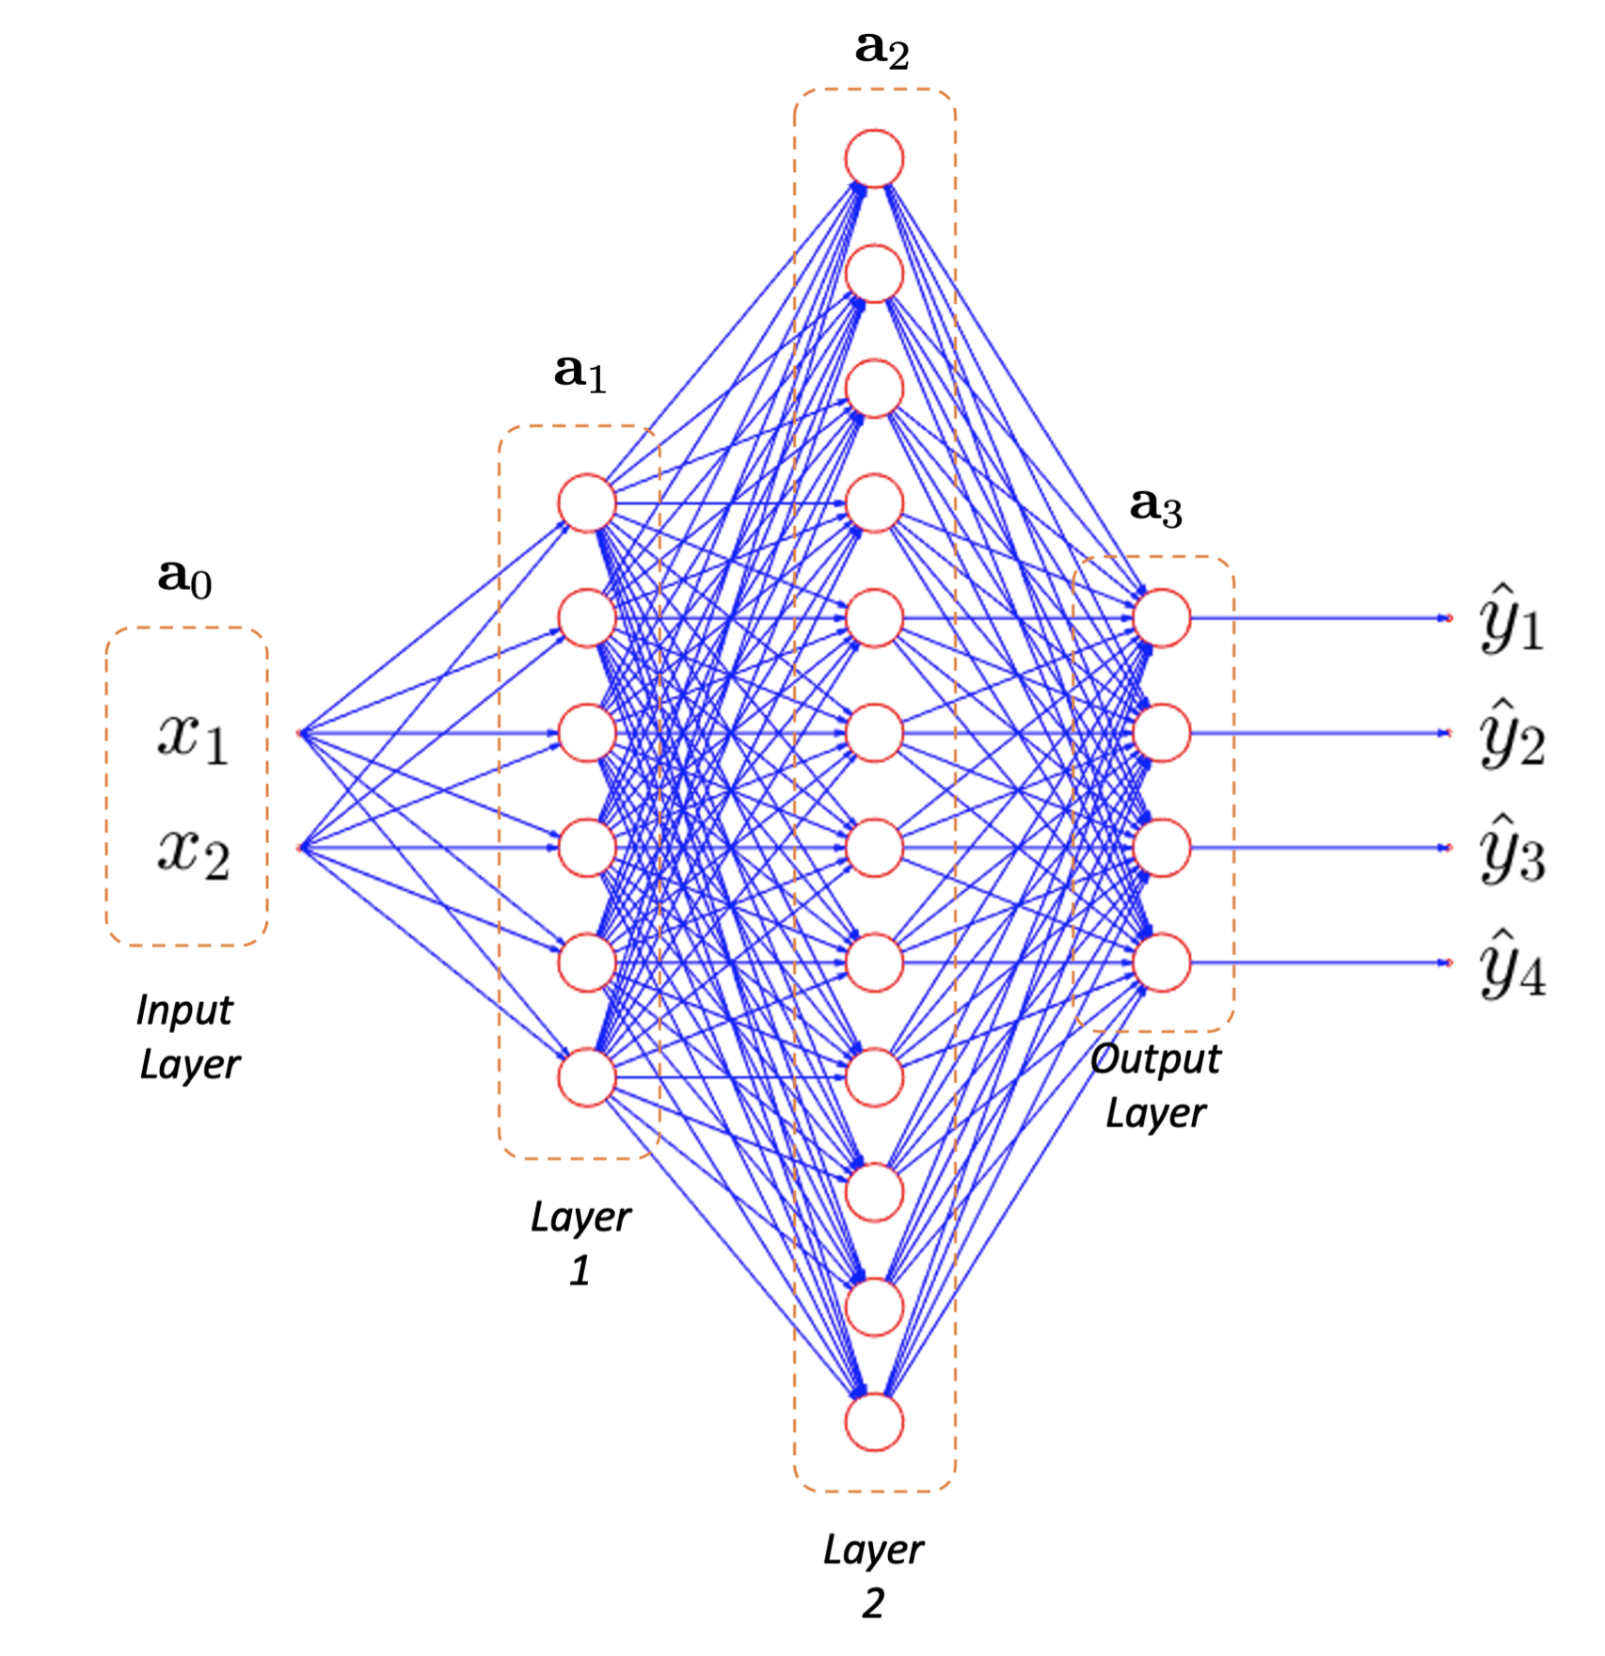
MOTIVATION
Neural networks

Slide 6
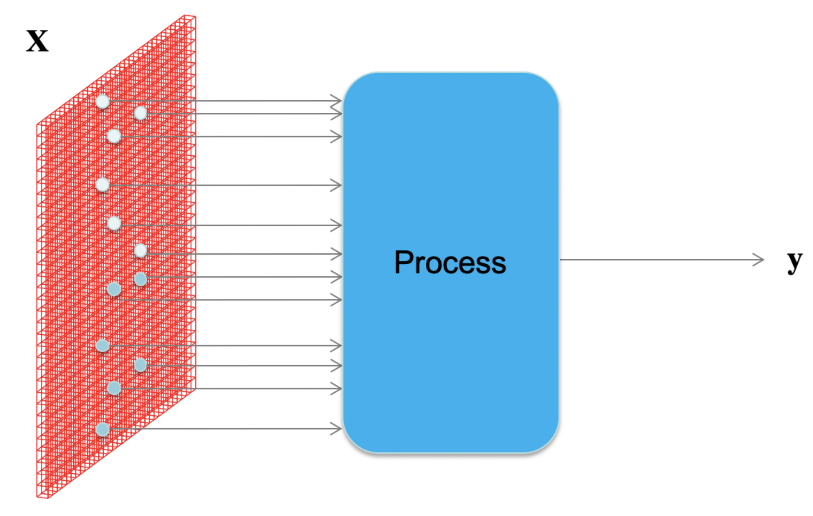
MOTIVATION
How to process an image with neural networks?

Slide 7
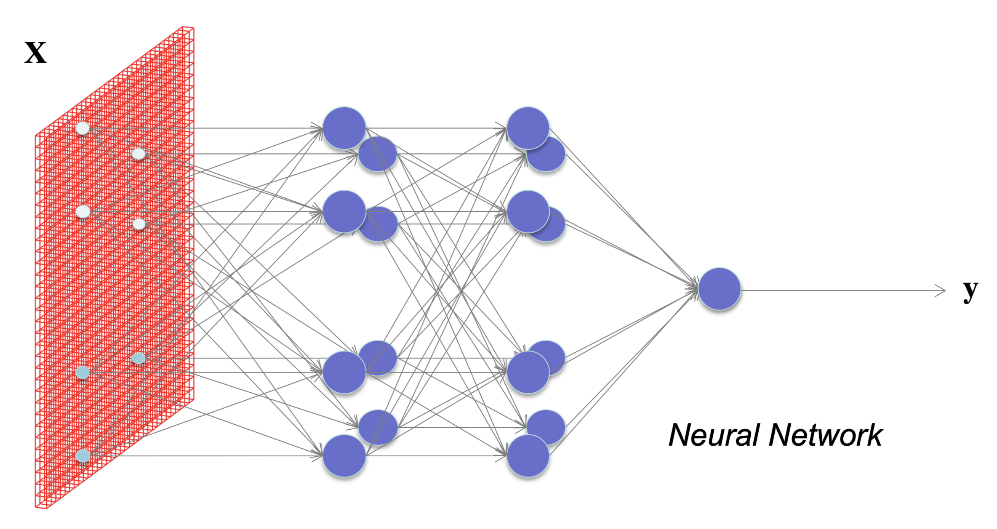

MOTIVATION
What happens if each pixel is an input?
How many neurons and weights?

Slide 8
Basics

Slide 9
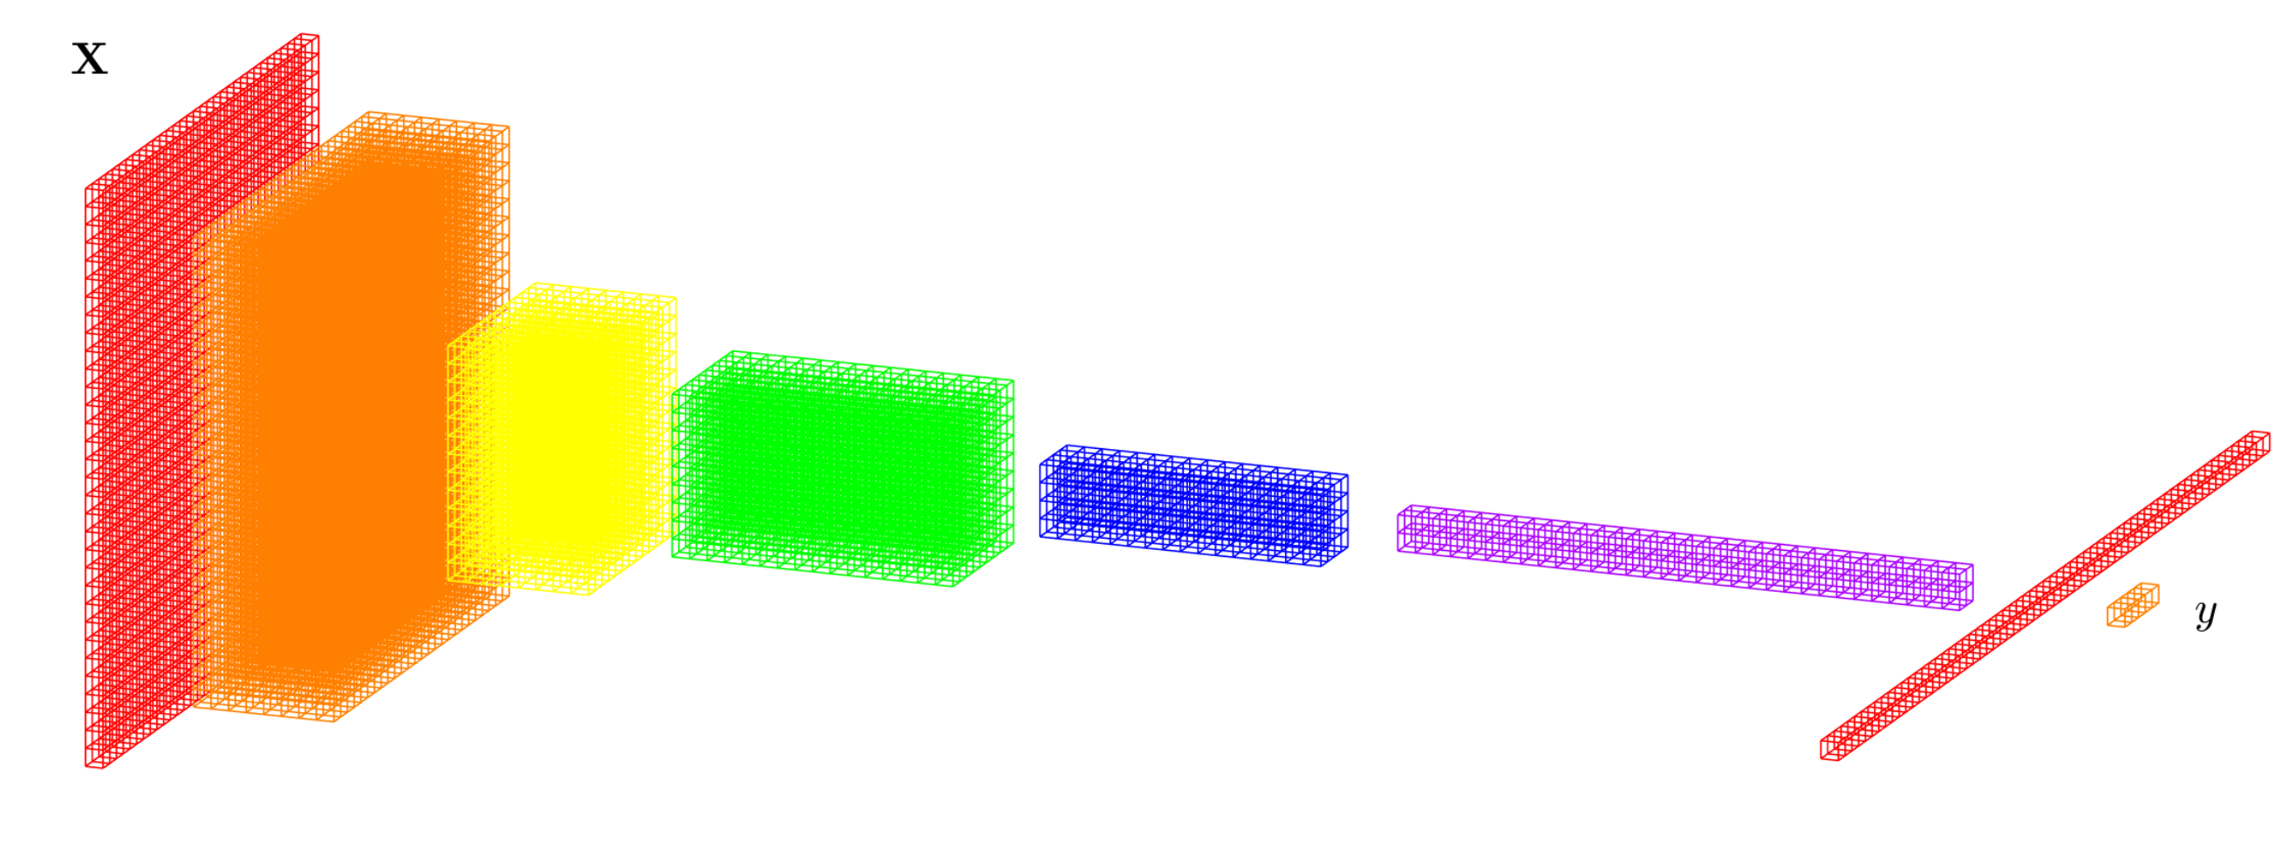
DEEP LEARNING BASICS (CNN)
Convolutional Neural Networks
Data
representation
Input
image
Layers
Classification

Slide 10
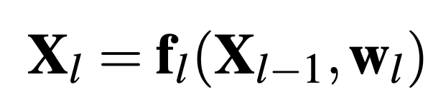
DEEP LEARNING BASICS (CNN)
Convolutional Neural Networks
f₁
f₂
f₃
f₄
f₅
f₇
f₆
Input
image
Layers
Classification

Slide 11
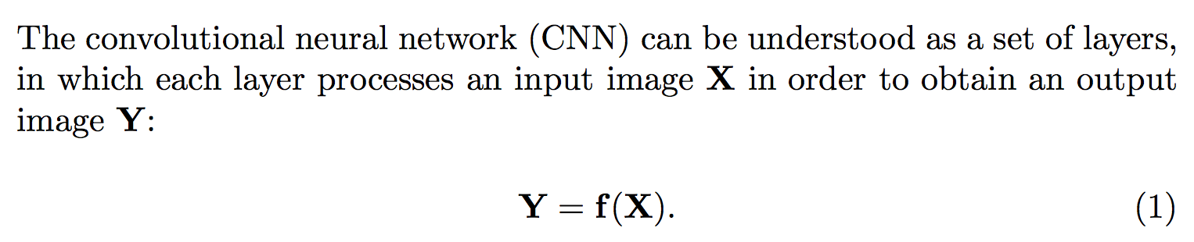
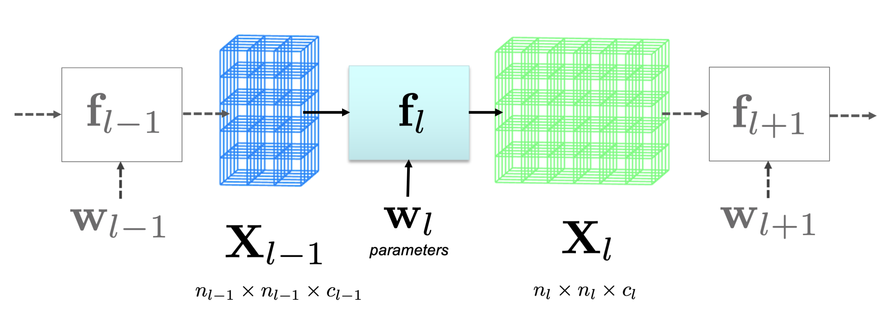
DEEP LEARNING BASICS

Slide 12
DEEP LEARNING: Typical layers
Convolution layer
Pooling layer
Rectified Linear Unit
Fully connected and SoftMax

Slide 13
DEEP LEARNING: Typical layers
Convolution layer
Pooling layer
Rectified Linear Unit
Fully connected and SoftMax

Slide 14
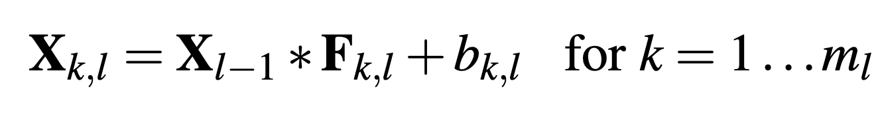
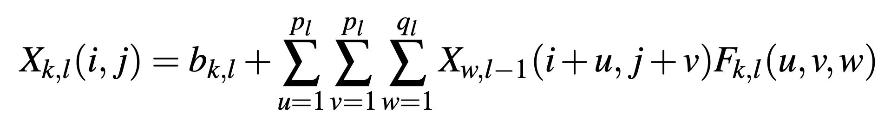
DEEP LEARNING: Convolution layer

Slide 15
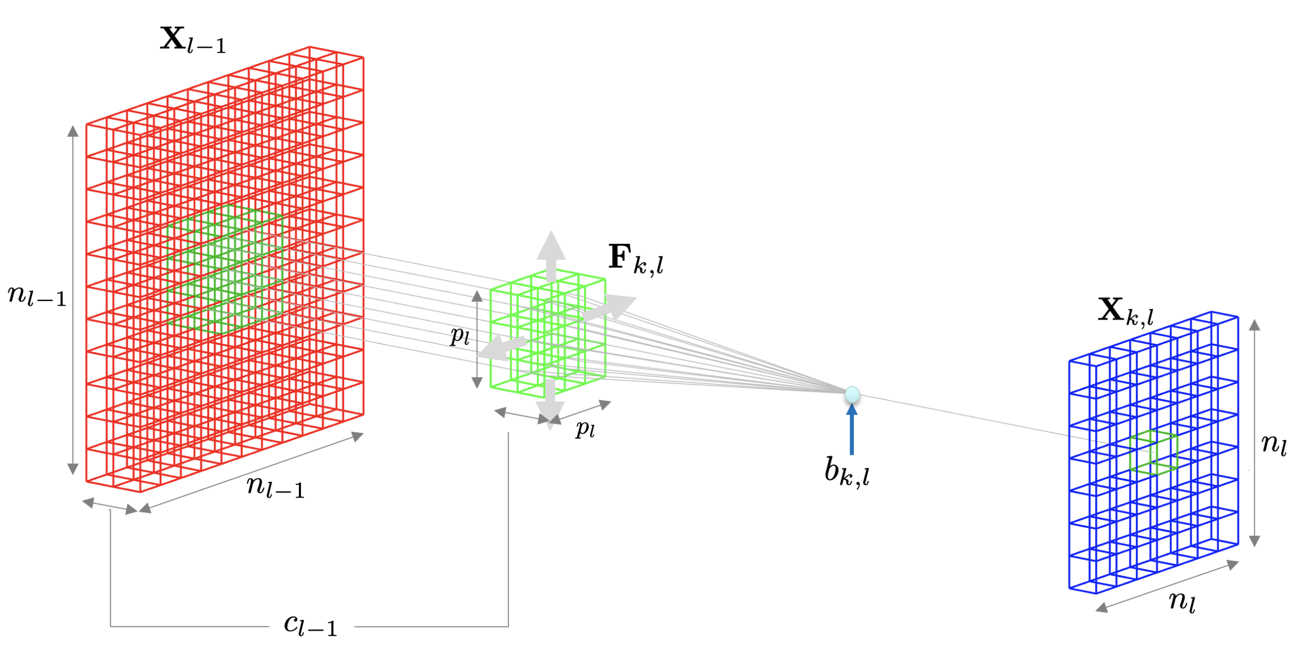
DEEP LEARNING: Convolution layer

Slide 16
DEEP LEARNING: Typical layers
Convolution layer
Pooling layer
Rectified Linear Unit
Fully connected and SoftMax

Slide 17
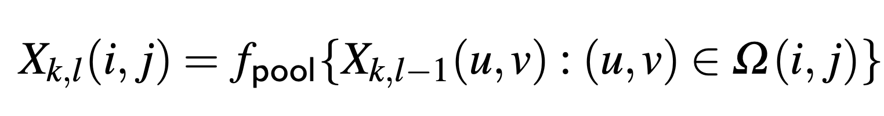
DEEP LEARNING: Pooling layer

Slide 18
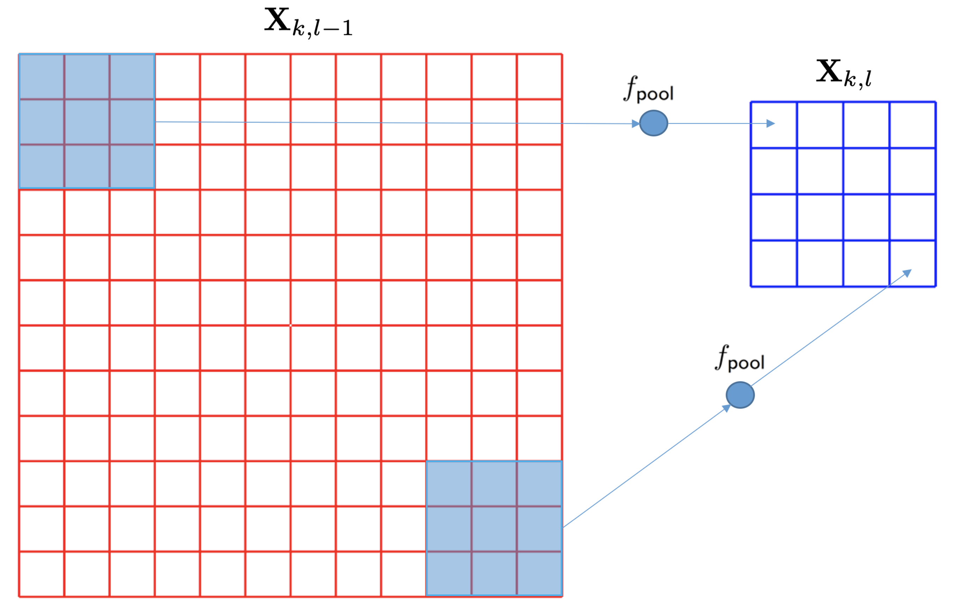
DEEP LEARNING: Pooling layer

Slide 19
DEEP LEARNING: Typical layers
Convolution layer
Pooling layer
Rectified Linear Unit
Fully connected and SoftMax

Slide 20
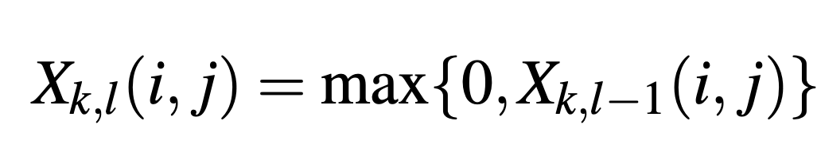
DEEP LEARNING: Rectified Linear Unit (ReLU)

Slide 21
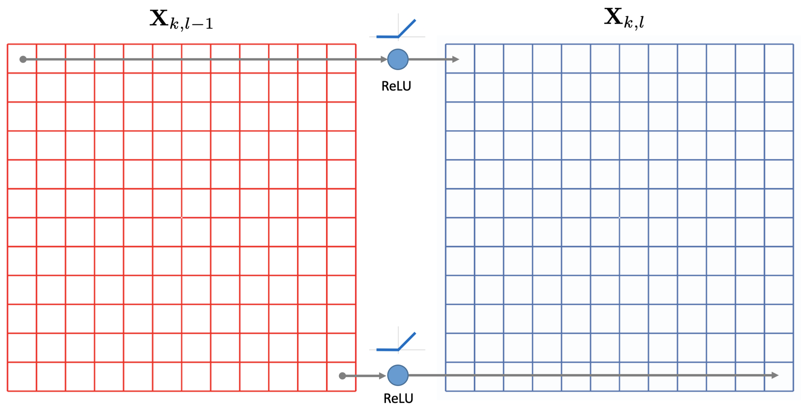
DEEP LEARNING: Rectified Linear Unit (ReLU)

Slide 22
DEEP LEARNING: Typical layers
Convolution layer
Pooling layer
Rectified Linear Unit
Fully connected and SoftMax

Slide 23
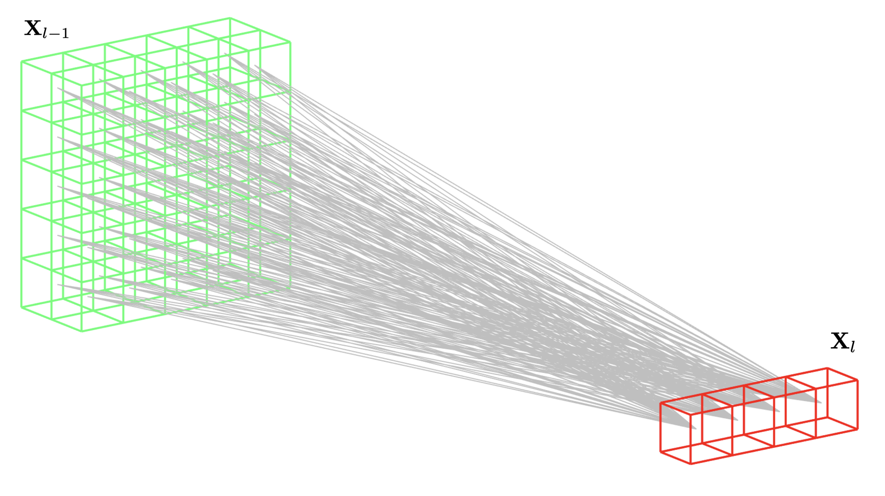
DEEP LEARNING: Fully Connected

Slide 24
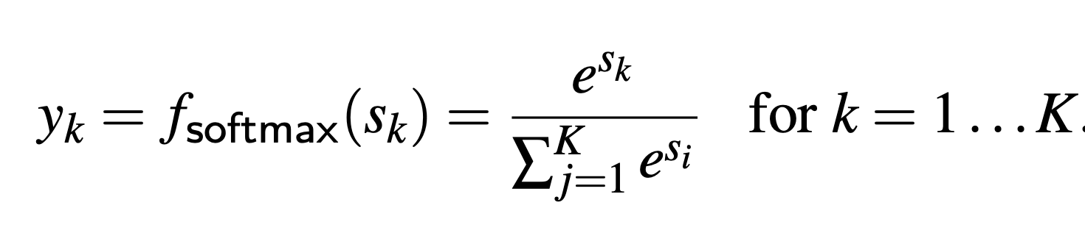
DEEP LEARNING: Fully Connected + SoftMax

Slide 25
Training

Slide 26
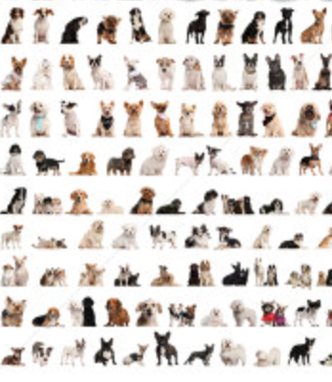


DEEP LEARNING: Training
dogs
errors
cats
Back-propagation

Slide 27
Example
Eyes vs. Nose Recognizer

Slide 28
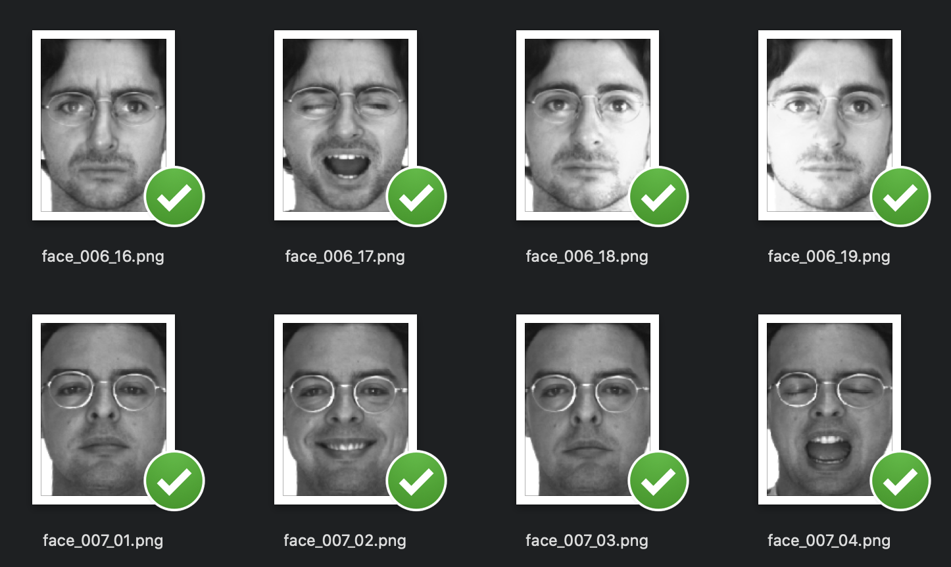
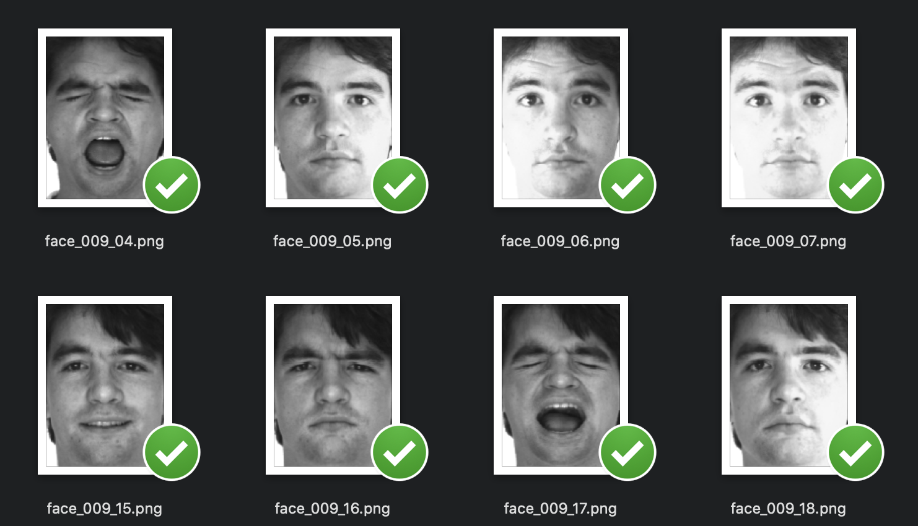

Slide 29
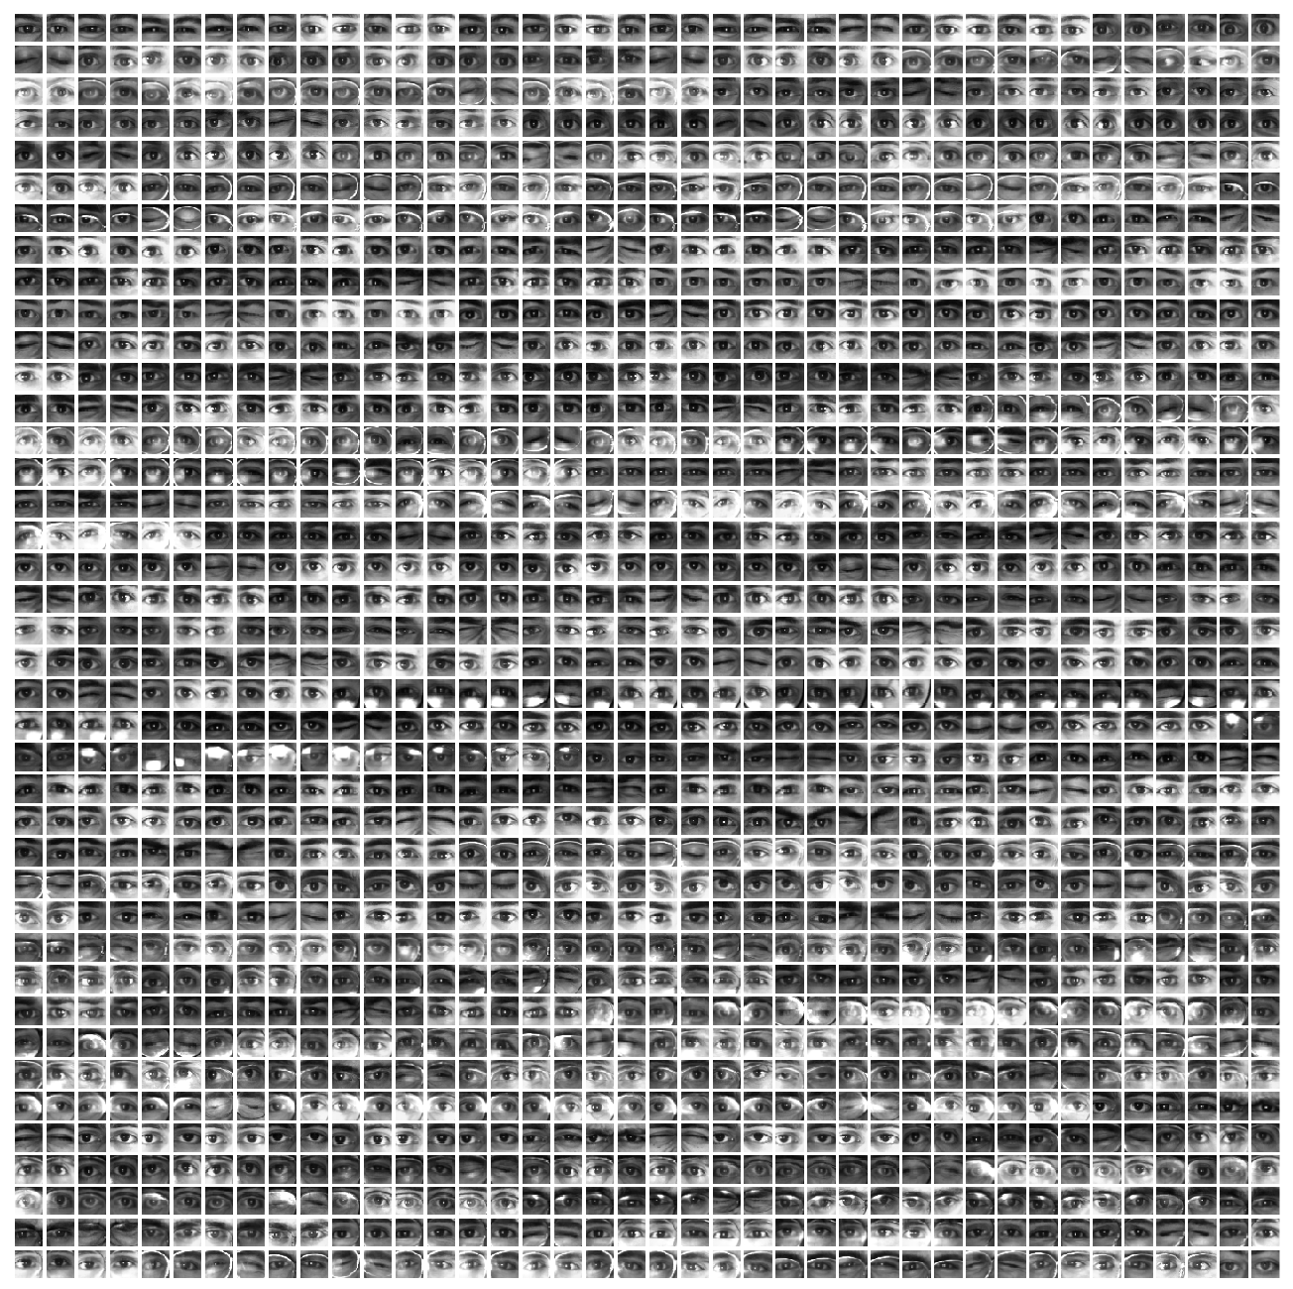
Eyes

Slide 30
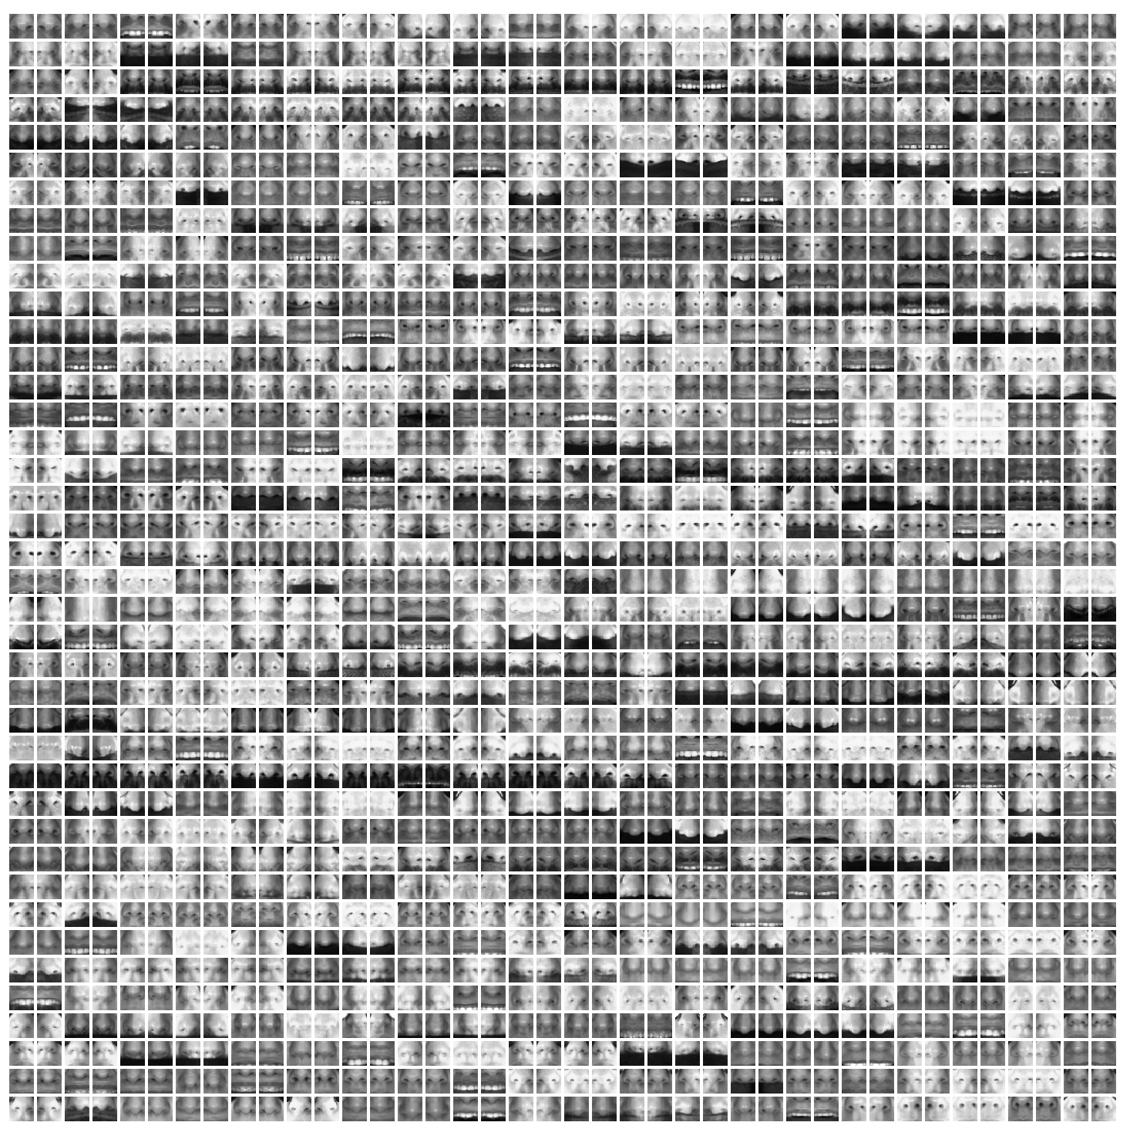
Noses

Slide 31
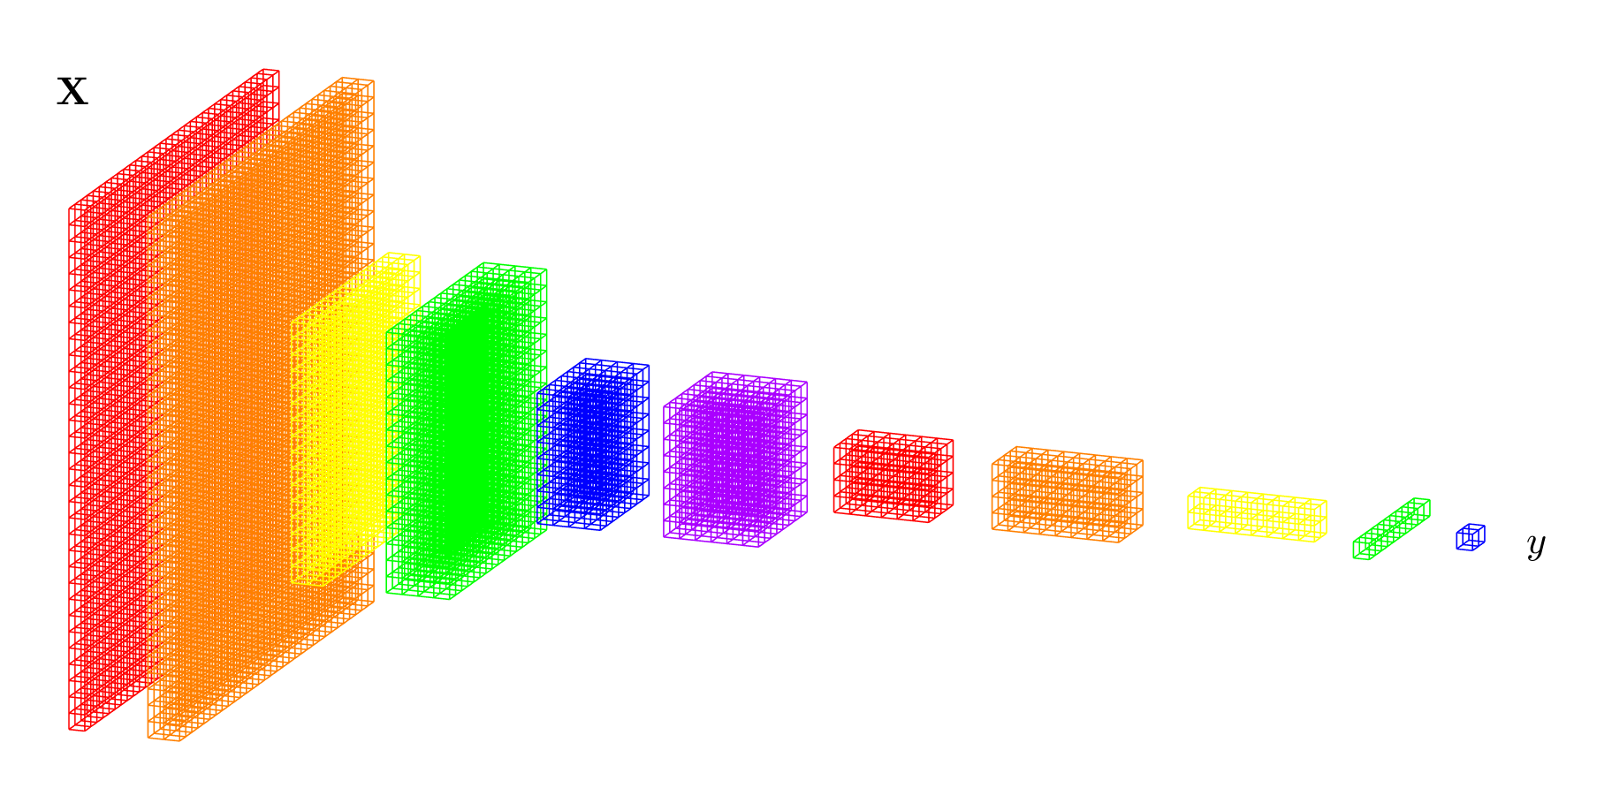

Slide 32
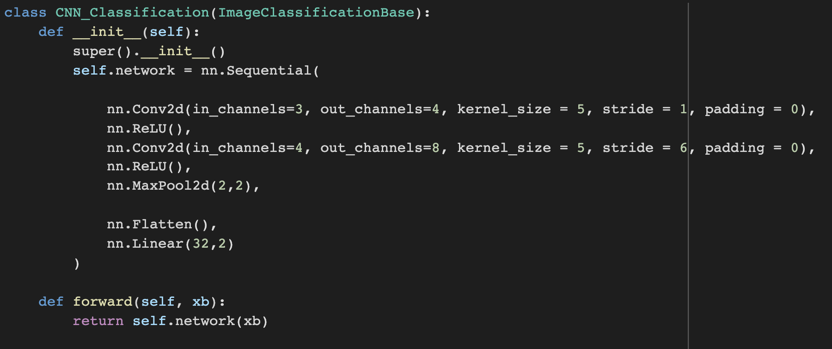
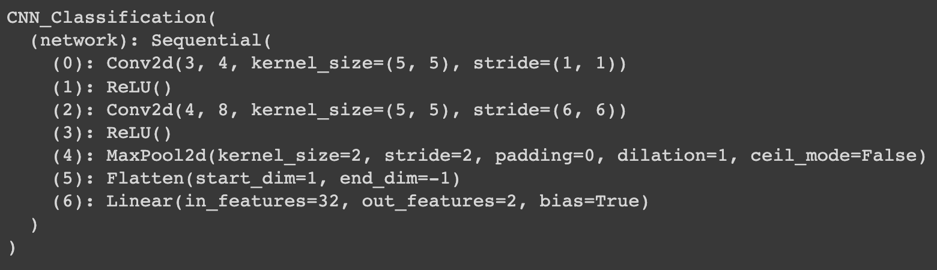
Implementation in PyTorch

Slide 33
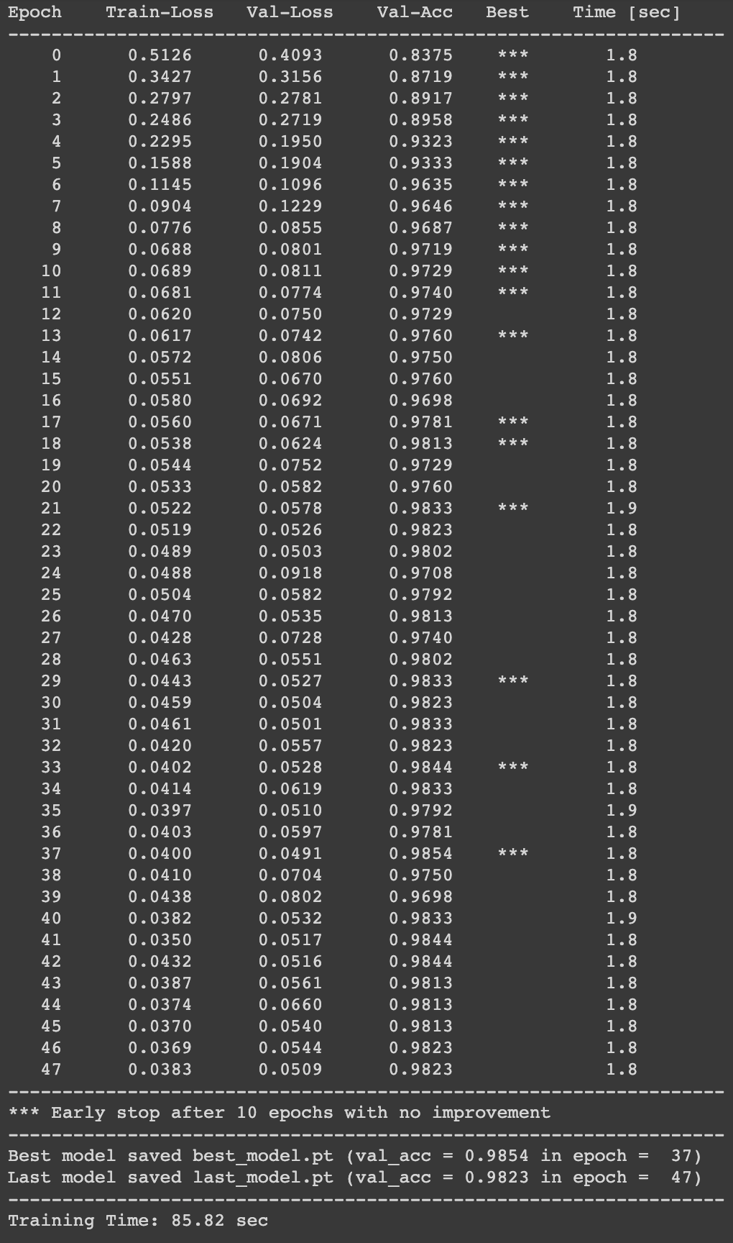
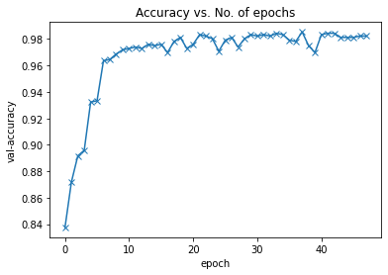
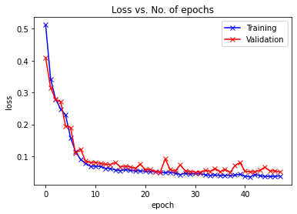

Slide 34
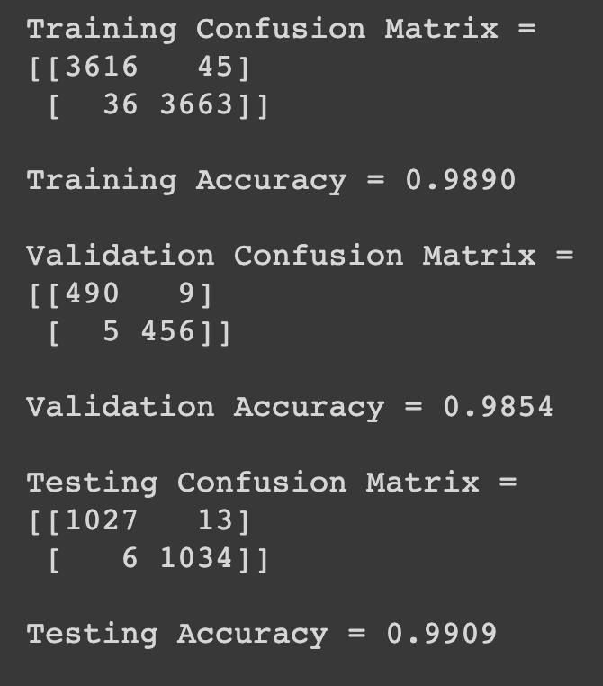

Slide 35
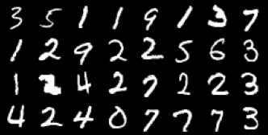
More Examples: MNIST

Slide 36
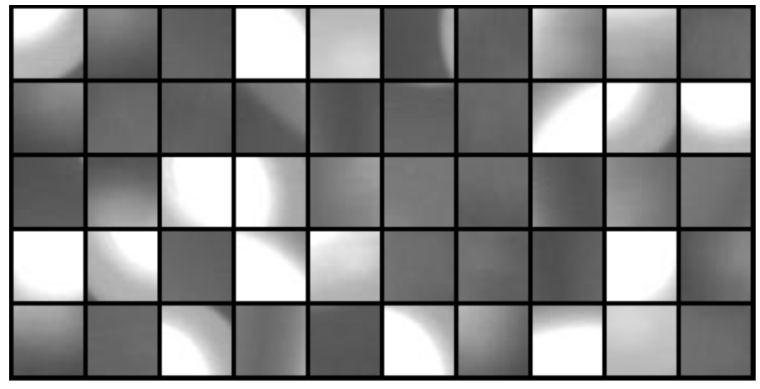
More Examples: Defects

Slide 37
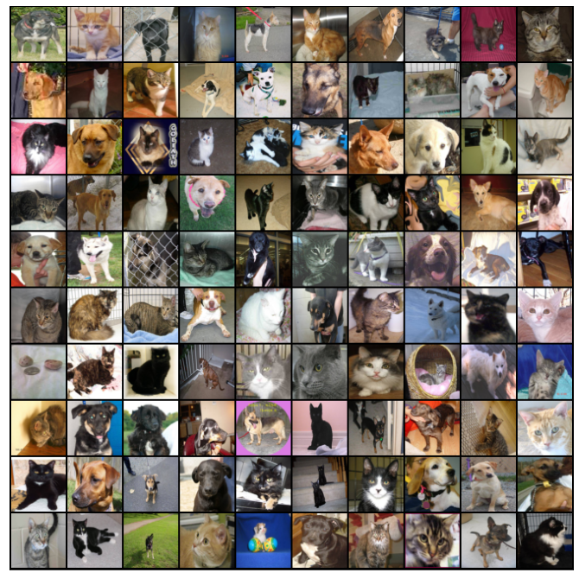
More Examples: Cats vs Dogs

Slide 38
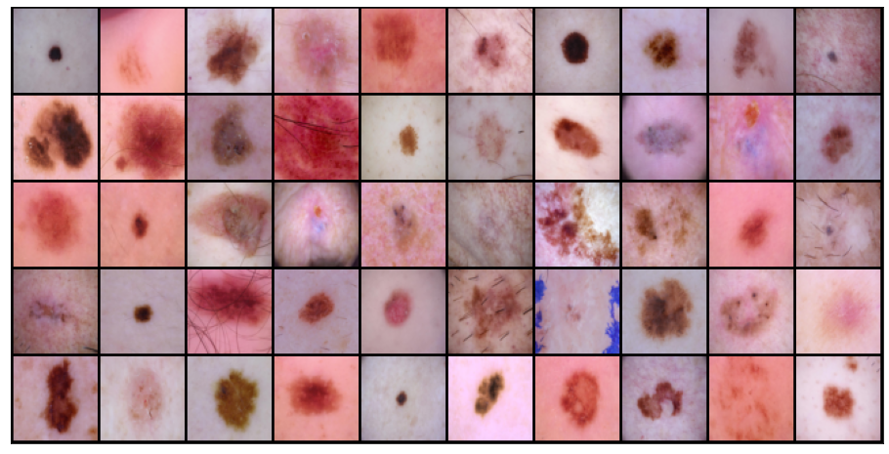
More Examples: Skin Cancer 2

Slide 39
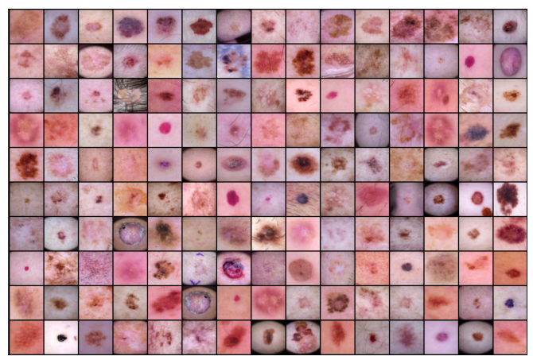
More Examples: Skin Cancer 7

Slide 40
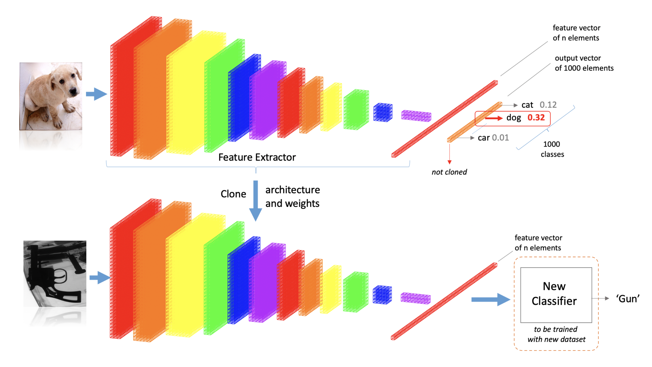
Pre-Trained Models

Slide 41
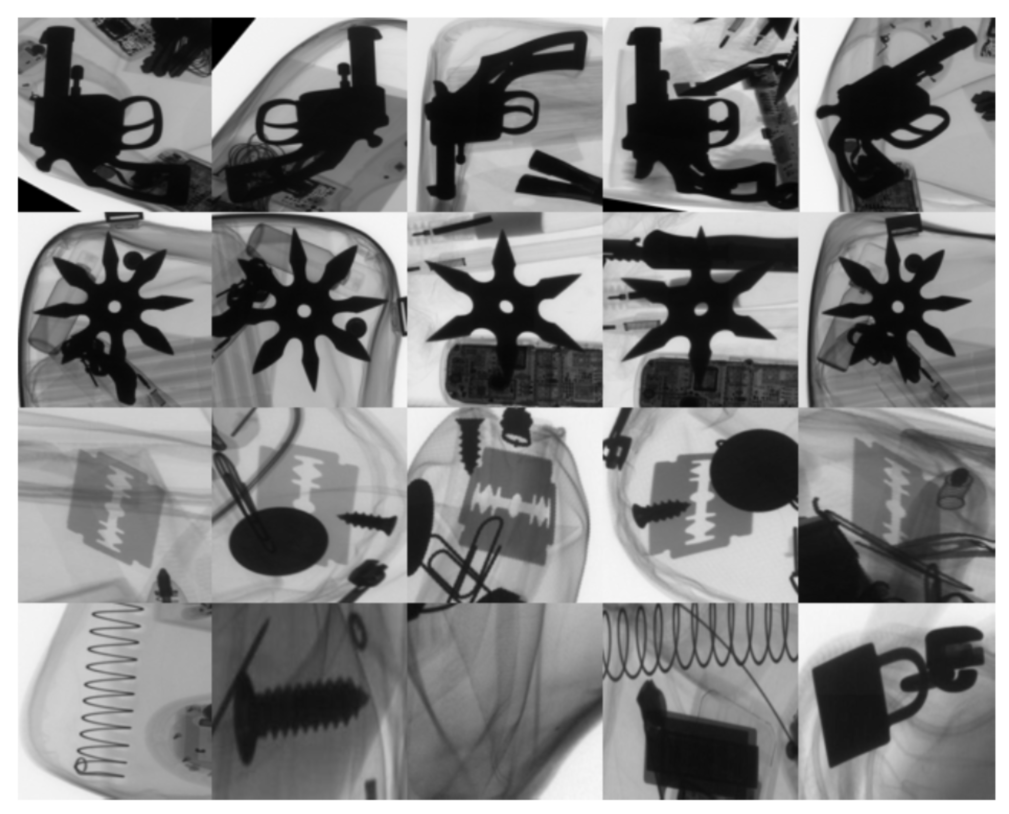

Slide 42
